Slide 1
Unit-IV
8086 Microprocessor

Slide 2
Microprocessor
Program controlled semiconductor device (IC) which fetches (from memory), decodes and executes instructions.
It is used as CPU (Central Processing Unit) in computers.

Slide 3
Microprocessor
Fifth Generation Pentium
Fourth Generation
During 1980s
Low power version of HMOS technology (HCMOS)
32 bit processors
Physical memory space 2²⁴ bytes = 16 Mb
Virtual memory space 2⁴⁰ bytes = 1 Tb
Floating point hardware
Supports increased number of addressing modes
Intel 80386
Third Generation
During 1978
HMOS technology ⇒ Faster speed, Higher packing density
16 bit processors ⇒ 40/ 48/ 64 pins
Easier to program
Dynamically relatable programs
Processor has multiply/ divide arithmetic hardware
More powerful interrupt handling capabilities
Flexible I/O port addressing
Intel 8086 (16 bit processor)
Second Generation
During 1973
NMOS technology ⇒ Faster speed, Higher density, Compatible with TTL
4 / 8/ 16 bit processors ⇒ 40 pins
Ability to address large memory spaces and I/O ports
Greater number of levels of subroutine nesting
Better interrupt handling capabilities
Intel 8085 (8 bit processor)
First Generation
Between 1971 – 1973
PMOS technology, non compatible with TTL
4 bit processors ⇒ 16 pins
8 and 16 bit processors ⇒ 40 pins
Due to limitations of pins, signals are multiplexed

Slide 4
Functional blocks
Microprocessor
Computational Unit; performs arithmetic and logic operations
Various conditions of the results are stored as status bits called flags in flag register
Internal storage of data
Register array or internal memory
Data Bus
ALU
Generates the address of the instructions to be fetched from the memory and send through address bus to the memory
Flag Register
Instruction decoding unit
Timing and control unit
PC/ IP
Control Bus
Address Bus
Generates control signals for internal and external operations of the microprocessor
Decodes instructions; sends information to the timing and control unit

Slide 5
Architecture

Slide 6
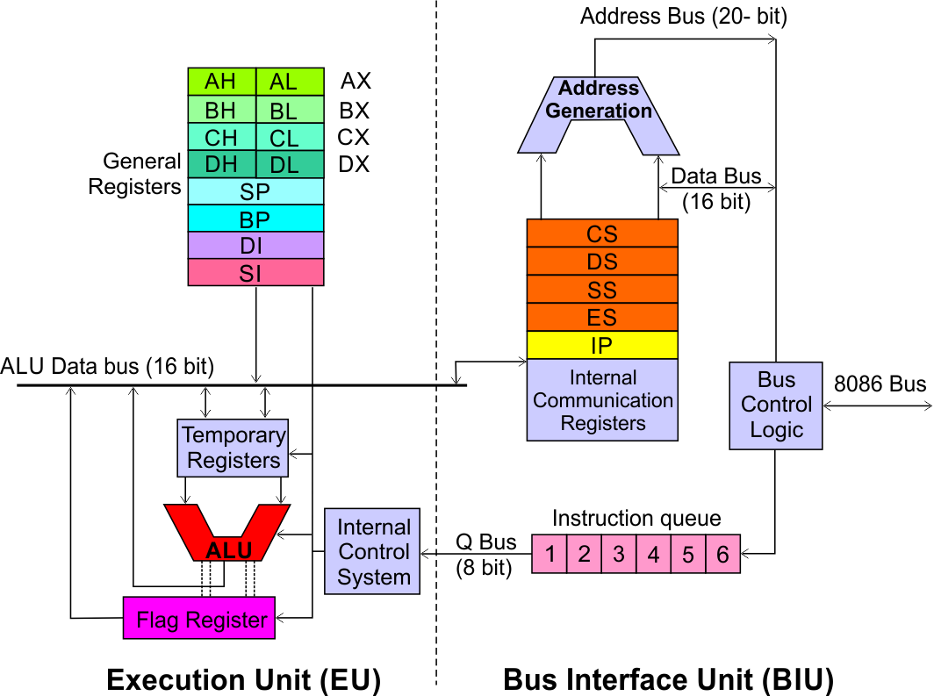
Architecture
8086 Microprocessor
Execution Unit (EU)
EU executes instructions that have already been fetched by the BIU.
BIU and EU functions separately.
Bus Interface Unit (BIU)
BIU fetches instructions, reads data from memory and I/O ports, writes data to memory and I/ O ports.

Slide 7
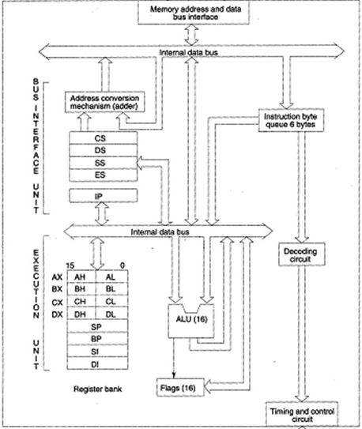
Detailed Architecture

Slide 8
Architecture
8086 Microprocessor
Bus Interface Unit (BIU)
Dedicated Adder to generate 20 bit address
Four 16-bit segment registers
Code Segment (CS)
Data Segment (DS)
Stack Segment (SS)
Extra Segment (ES)
Segment Registers >>

Slide 9
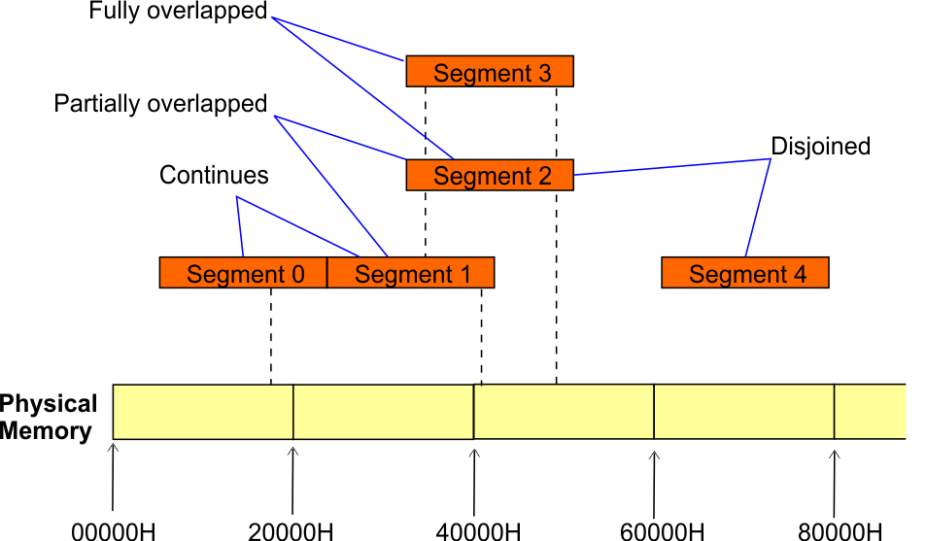
Architecture
8086 Microprocessor
Bus Interface Unit (BIU)
Segment
Registers
8086’s 1-megabyte memory is divided into segments of up to 64K bytes each.
The 8086 can directly address four segments (256 K bytes within the 1 M byte of memory) at a particular time.
Programs obtain access to code and data in the segments by changing the segment register content to point to the desired segments.

Slide 10
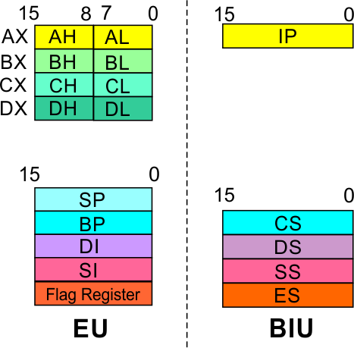
Architecture
8086 Microprocessor
Bus Interface Unit (BIU)
Segment
Registers
Code Segment Register
16-bit
CS contains the base or start of the current code segment; IP contains the distance or offset from this address to the next instruction byte to be fetched.
BIU computes the 20-bit physical address by logically shifting the contents of CS 4-bits to the left and then adding the 16-bit contents of IP.
That is, all instructions of a program are relative to the contents of the CS register multiplied by 16 and then offset is added provided by the IP.

Slide 11
Architecture
8086 Microprocessor
Bus Interface Unit (BIU)
Segment
Registers
Data Segment Register
16-bit
Points to the current data segment; operands for most instructions are fetched from this segment.
The 16-bit contents of the Source Index (SI) or Destination Index (DI) or a 16-bit displacement are used as offset for computing the 20-bit physical address.

Slide 12
Architecture
8086 Microprocessor
Bus Interface Unit (BIU)
Segment
Registers
Stack Segment Register
16-bit
Points to the current stack.
The 20-bit physical stack address is calculated from the Stack Segment (SS) and the Stack Pointer (SP) for stack instructions such as PUSH and POP.
In based addressing mode, the 20-bit physical stack address is calculated from the Stack segment (SS) and the Base Pointer (BP).

Slide 13
Architecture
8086 Microprocessor
Bus Interface Unit (BIU)
Segment
Registers
Extra Segment Register
16-bit
Points to the extra segment in which data (in excess of 64K pointed to by the DS) is stored.
String instructions use the ES and DI to determine the 20-bit physical address for the destination.

Slide 14
Architecture
8086 Microprocessor
Bus Interface Unit (BIU)
Segment
Registers
Instruction Pointer
16-bit
Always points to the next instruction to be executed within the currently executing code segment.
So, this register contains the 16-bit offset address pointing to the next instruction code within the 64Kb of the code segment area.
Its content is automatically incremented as the execution of the next instruction takes place.

Slide 15
Architecture
8086 Microprocessor
Bus Interface Unit (BIU)
Instruction queue
A group of First-In-First-Out (FIFO) in which up to 6 bytes of instruction code are pre fetched from the memory ahead of time.
This is done in order to speed up the execution by overlapping instruction fetch with execution.
This mechanism is known as pipelining.

Slide 16
Architecture
8086 Microprocessor
Execution Unit (EU)
EU decodes and executes instructions.
A decoder in the EU control system translates instructions.
16-bit ALU for performing arithmetic and logic operation
Four general purpose registers(AX, BX, CX, DX);
Pointer registers (Stack Pointer, Base Pointer);
and
Index registers (Source Index, Destination Index) each of 16-bits
Some of the 16 bit registers can be used as two 8 bit registers as :
AX can be used as AH and AL
BX can be used as BH and BL
CX can be used as CH and CL
DX can be used as DH and DL

Slide 17
Architecture
8086 Microprocessor
Execution Unit (EU)
EU
Registers
Accumulator Register (AX)
Consists of two 8-bit registers AL and AH, which can be combined together and used as a 16-bit register AX.
AL in this case contains the low order byte of the word, and AH contains the high-order byte.
The I/O instructions use the AX or AL for inputting / outputting 16 or 8 bit data to or from an I/O port.
Multiplication and Division instructions also use the AX or AL.

Slide 18
Architecture
8086 Microprocessor
Execution Unit (EU)
EU
Registers
Base Register (BX)
Consists of two 8-bit registers BL and BH, which can be combined together and used as a 16-bit register BX.
BL in this case contains the low-order byte of the word, and BH contains the high-order byte.
This is the only general purpose register whose contents can be used for addressing the 8086 memory.
All memory references utilizing this register content for addressing use DS as the default segment register.

Slide 19
Architecture
8086 Microprocessor
Execution Unit (EU)
EU
Registers
Counter Register (CX)
Consists of two 8-bit registers CL and CH, which can be combined together and used as a 16-bit register CX.
When combined, CL register contains the low order byte of the word, and CH contains the high-order byte.
Instructions such as SHIFT, ROTATE and LOOP use the contents of CX as a counter.
Example:
The instruction LOOP START automatically decrements CX by 1 without affecting flags and will check if [CX] = 0.
If it is zero, 8086 executes the next instruction; otherwise the 8086 branches to the label START.

Slide 20
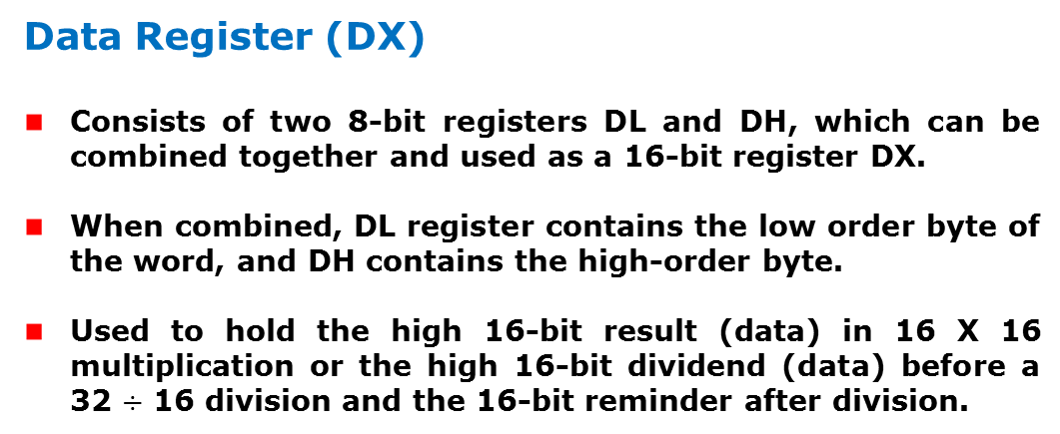
Architecture
8086 Microprocessor
Execution Unit (EU)
EU
Registers
Data Register (DX)
Consists of two 8-bit registers DL and DH, which can be combined together and used as a 16-bit register DX.
When combined, DL register contains the low order byte of the word, and DH contains the high-order byte.
Used to hold the high 16-bit result (data) in 16 X 16 multiplication or the high 16-bit dividend (data) before a 32 $÷$ 16 division and the 16-bit reminder after division.

Slide 21
Architecture
8086 Microprocessor
Execution Unit (EU)
EU
Registers
Stack Pointer (SP) and Base Pointer (BP)
SP and BP are used to access data in the stack segment.
SP is used as an offset from the current SS during execution of instructions that involve the stack segment in the external memory.
SP contents are automatically updated (incremented/ decremented) due to execution of a POP or PUSH instruction.
BP contains an offset address in the current SS, which is used by instructions utilizing the based addressing mode.

Slide 22
Architecture
8086 Microprocessor
Execution Unit (EU)
EU
Registers
Source Index (SI) and Destination Index (DI)
Used in indexed addressing.
Instructions that process data strings use the SI and DI registers together with DS and ES respectively in order to distinguish between the source and destination addresses.

Slide 23
Architecture
8086 Microprocessor
Execution Unit (EU)
EU
Registers
Source Index (SI) and Destination Index (DI)
Used in indexed addressing.
Instructions that process data strings use the SI and DI registers together with DS and ES respectively in order to distinguish between the source and destination addresses.

Slide 24
Architecture
8086 Microprocessor
Execution Unit (EU)
Auxiliary Carry Flag
This is set, if there is a carry from the lowest nibble, i.e, bit three during addition, or borrow for the lowest nibble, i.e, bit three, during subtraction.
Carry Flag
This flag is set, when there is a carry out of MSB in case of addition or a borrow in case of subtraction.
Flag Register
Sign Flag
This flag is set, when the result of any computation is negative
Zero Flag
This flag is set, if the result of the computation or comparison performed by an instruction is zero
Parity Flag
This flag is set to 1, if the lower byte of the result contains even number of 1’s ; for odd number of 1’s set to zero.
15 | 14 | 13 | 12 | 11 | 10 | 9 | 8 | 7 | 6 | 5 | 4 | 3 | 2 | 1 | 0
 |  |  |  | OF | DF | IF | TF | SF | ZF |  | AF |  | PF |  | CF
Over flow Flag
This flag is set, if an overflow occurs, i.e, if the result of a signed operation is large enough to accommodate in a destination register. The result is of more than 7-bits in size in case of 8-bit signed operation and more than 15-bits in size in case of 16-bit sign operations, then the overflow will be set.
Tarp Flag
If this flag is set, the processor enters the single step execution mode by generating internal interrupts after the execution of each instruction
Direction Flag
This is used by string manipulation instructions. If this flag bit is ‘0’, the string is processed beginning from the lowest address to the highest address, i.e., auto incrementing mode. Otherwise, the string is processed from the highest address towards the lowest address, i.e., auto incrementing mode.
Interrupt Flag
Causes the 8086 to recognize external mask interrupts; clearing IF disables these interrupts.

Slide 25
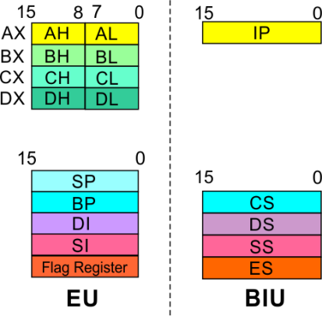
8086 Microprocessor
Architecture
8086 registers categorized into 4 groups
15 | 14 | 13 | 12 | 11 | 10 | 9 | 8 | 7 | 6 | 5 | 4 | 3 | 2 | 1 | 0
 |  |  |  | OF | DF | IF | TF | SF | ZF |  | AF |  | PF |  | CF
Sl.No. | Type | Register width | Name of register
1 | General purpose register | 16 bit | AX, BX, CX, DX
 |  | 8 bit | AL, AH, BL, BH, CL, CH, DL, DH
2 | Pointer register | 16 bit | SP, BP
3 | Index register | 16 bit | SI, DI
4 | Instruction Pointer | 16 bit | IP
5 | Segment register | 16 bit | CS, DS, SS, ES
6 | Flag (PSW) | 16 bit | Flag register

Slide 26
8086 Microprocessor
Architecture
Registers and Special Functions
Register | Name of the Register | Special Function
AX | 16-bit Accumulator | Stores the 16-bit results of arithmetic and logic operations
AL | 8-bit Accumulator | Stores the 8-bit results of arithmetic and logic operations
BX | Base register | Used to hold base value in base addressing mode to access memory data
CX | Count Register | Used to hold the count value in SHIFT, ROTATE and LOOP instructions
DX | Data Register | Used to hold data for multiplication and division operations
SP | Stack Pointer | Used to hold the offset address of top stack memory
BP | Base Pointer | Used to hold the base value in base addressing using SS register to access data from stack memory
SI | Source Index | Used to hold index value of source operand (data) for string instructions
DI | Data Index | Used to hold the index value of destination operand (data) for string operations

Slide 27
ADDRESSING MODES & Instruction set

Slide 28
Introduction
8086 Microprocessor
Program
A set of instructions written to solve a problem.
Instruction
Directions which a microprocessor follows to execute a task or part of a task.
Computer language
High Level
Low Level
Machine Language
Assembly Language
 Binary bits
English Alphabets
‘Mnemonics’
Assembler Mnemonics → Machine Language

Slide 29
Introduction
8086 Microprocessor
Program is a set of instructions written to solve a problem. Instructions are the directions which a microprocessor follows to execute a task or part of a task. Broadly, computer language can be divided into two parts as high-level language and low level language. Low level language are machine specific. Low level language can be further divided into machine language and assembly language.
Machine language is the only language which a machine can understand. Instructions in this language are written in binary bits as a specific bit pattern. The computer interprets this bit pattern as an instruction to perform a particular task. The entire program is a sequence of binary numbers. This is a machine-friendly language but not user friendly. Debugging is another problem associated with machine language.
To overcome these problems, programmers develop another way in which instructions are written in English alphabets. This new language is known as Assembly language. The instructions in this language are termed mnemonics. As microprocessor can only understand the machine language so mnemonics are translated into machine language either manually or by a program known as assembler.
Efficient software development for the microprocessor requires a complete familiarity with the instruction set, their format and addressing modes. Here in this chapter, we will focus on the addressing modes and instructions formats of microprocessor 8086.

Slide 30
ADDRESSING MODES

Slide 31
Addressing Modes
8086 Microprocessor
Every instruction of a program has to operate on a data.
The different ways in which a source operand is denoted in an instruction are known as addressing modes.
Register Addressing
Immediate Addressing
Direct Addressing
Register Indirect Addressing
Based Addressing
Indexed Addressing
Based Index Addressing
String Addressing
Direct I/O port Addressing
10. Indirect I/O port Addressing
11. Relative Addressing
12. Implied Addressing
Group I : Addressing modes for register and immediate data
Group II : Addressing modes for memory data
Group III : Addressing modes for I/O ports
Group IV : Relative Addressing mode
Group V : Implied Addressing mode

Slide 32
Addressing Modes
8086 Microprocessor
Group I : Addressing modes for register and immediate data
Register Addressing
Immediate Addressing
Direct Addressing
Register Indirect Addressing
Based Addressing
Indexed Addressing
Based Index Addressing
String Addressing
Direct I/O port Addressing
10. Indirect I/O port Addressing
11. Relative Addressing
12. Implied Addressing
The instruction will specify the name of the register which holds the data to be operated by the instruction.
Example:
MOV CL, DH
The content of 8-bit register DH is moved to another 8-bit register CL
(CL) ← (DH)

Slide 33

Addressing Modes
8086 Microprocessor
Group I : Addressing modes for register and immediate data
Register Addressing
Immediate Addressing
Direct Addressing
Register Indirect Addressing
Based Addressing
Indexed Addressing
Based Index Addressing
String Addressing
Direct I/O port Addressing
10. Indirect I/O port Addressing
11. Relative Addressing
12. Implied Addressing
In immediate addressing mode, an 8-bit or 16-bit data is specified as part of the instruction
Example:
MOV DL, 08H
The 8-bit data (08_{H}) given in the instruction is moved to DL
(DL) ← 08_{H}
MOV AX, 0A9FH
The 16-bit data (0A9F_{H}) given in the instruction is moved to AX register
(AX) ← 0A9F_{H}

Slide 34
Addressing Modes : Memory Access
8086 Microprocessor
Offset Value (16 bits)
Segment Register (16 bits)
0 0 0 0
Adder
Physical Address (20 Bits)

Slide 35
Addressing Modes : Memory Access
8086 Microprocessor
20 Address lines ⇒ 8086 can address up to 2²⁰ = 1M bytes of memory
However, the largest register is only 16 bits
Physical Address will have to be calculated Physical Address : Actual address of a byte in memory. i.e. the value which goes out onto the address bus.
Memory Address represented in the form – Seg : Offset (Eg - 89AB:F012)
Each time the processor wants to access memory, it takes the contents of a segment register, shifts it one hexadecimal place to the left (same as multiplying by 16₁₀), then add the required offset to form the 20- bit address
16 bytes of contiguous memory
89AB : F012 → 89AB → 89AB0 (Paragraph to byte → 89AB x 10 = 89AB0)
F012 → 0F012 (Offset is already in byte unit)
+ -------
98AC2 (The absolute address)

Slide 36
Addressing Modes : Memory Access
8086 Microprocessor
To access memory we use these four registers: BX, SI, DI, BP
Combining these registers inside [ ] symbols, we can get different memory locations (Effective Address, EA)
Supported combinations:
[BX + SI] [BX + DI] [BP + SI] [BP + DI] | [SI] [DI] d16 (variable offset only) [BX] | [BX + SI + d8] [BX + DI + d8] [BP + SI + d8] [BP + DI + d8]
[SI + d8] [DI + d8] [BP + d8] [BX + d8] | [BX + SI + d16] [BX + DI + d16] [BP + SI + d16] [BP + DI + d16] | [SI + d16] [DI + d16] [BP + d16] [BX + d16]
BX BP | SI DI | + disp

Slide 37
Addressing Modes
8086 Microprocessor
Group II : Addressing modes for memory data
Register Addressing
Immediate Addressing
Direct Addressing
Register Indirect Addressing
Based Addressing
Indexed Addressing
Based Index Addressing
String Addressing
Direct I/O port Addressing
10. Indirect I/O port Addressing
11. Relative Addressing
12. Implied Addressing
Here, the effective address of the memory location at which the data operand is stored is given in the instruction.
The effective address is just a 16-bit number written directly in the instruction.
Example:
MOV BX, [1354H]
MOV BL, [0400H]
The square brackets around the 1354_{H} denotes the contents of the memory location. When executed, this instruction will copy the contents of the memory location into BX register.
This addressing mode is called direct because the displacement of the operand from the segment base is specified directly in the instruction.

Slide 38
Addressing Modes
8086 Microprocessor
Group II : Addressing modes for memory data
Register Addressing
Immediate Addressing
Direct Addressing
Register Indirect Addressing
Based Addressing
Indexed Addressing
Based Index Addressing
String Addressing
Direct I/O port Addressing
10. Indirect I/O port Addressing
11. Relative Addressing
12. Implied Addressing
In Register indirect addressing, name of the register which holds the effective address (EA) will be specified in the instruction.
Registers used to hold EA are any of the following registers:
BX, BP, DI and SI.
Content of the DS register is used for base address calculation.
Example:
MOV CX, [BX]
Operations:
EA = (BX)
BA = (DS) x 16₁₀
MA = BA + EA
(CX) ← (MA) or,
(CL) ← (MA)
(CH) ← (MA +1)
Note : Register/ memory enclosed in brackets refer to content of register/ memory

Slide 39
Addressing Modes
8086 Microprocessor
Group II : Addressing modes for memory data
Register Addressing
Immediate Addressing
Direct Addressing
Register Indirect Addressing
Based Addressing
Indexed Addressing
Based Index Addressing
String Addressing
Direct I/O port Addressing
10. Indirect I/O port Addressing
11. Relative Addressing
12. Implied Addressing
In Based Addressing, BX or BP is used to hold the base value for effective address and a signed 8-bit or unsigned 16-bit displacement will be specified in the instruction.
In case of 8-bit displacement, it is sign extended to 16-bit before adding to the base value.
When BX holds the base value of EA, 20-bit physical address is calculated from BX and DS.
When BP holds the base value of EA, BP and SS is used.
Example:
MOV AX, [BX + 08H]
Operations:
0008_{H} ← 08_{H} (Sign extended)
EA = (BX) + 0008_{H}
BA = (DS) x 16₁₀
MA = BA + EA
(AX) ← (MA) or,
(AL) ← (MA)
(AH) ← (MA + 1)

Slide 40
Addressing Modes
8086 Microprocessor
Group II : Addressing modes for memory data
Register Addressing
Immediate Addressing
Direct Addressing
Register Indirect Addressing
Based Addressing
Indexed Addressing
Based Index Addressing
String Addressing
Direct I/O port Addressing
10. Indirect I/O port Addressing
11. Relative Addressing
12. Implied Addressing
SI or DI register is used to hold an index value for memory data and a signed 8-bit or unsigned 16-bit displacement will be specified in the instruction.
Displacement is added to the index value in SI or DI register to obtain the EA.
In case of 8-bit displacement, it is sign extended to 16-bit before adding to the base value.
Example:
MOV CX, [SI + 0A2H]
Operations:
FFA2_{H} ← A2_{H} (Sign extended)
EA = (SI) + FFA2_{H}
BA = (DS) x 16₁₀
MA = BA + EA
(CX) ← (MA) or,
(CL) ← (MA)
(CH) ← (MA + 1)

Slide 41
Addressing Modes
8086 Microprocessor
Group II : Addressing modes for memory data
Register Addressing
Immediate Addressing
Direct Addressing
Register Indirect Addressing
Based Addressing
Indexed Addressing
Based Index Addressing
String Addressing
Direct I/O port Addressing
10. Indirect I/O port Addressing
11. Relative Addressing
12. Implied Addressing
In Based Index Addressing, the effective address is computed from the sum of a base register (BX or BP), an index register (SI or DI) and a displacement.
Example:
MOV DX, [BX + SI + 0AH]
Operations:
000A_{H} ← 0A_{H} (Sign extended)
EA = (BX) + (SI) + 000A_{H}
BA = (DS) x 16₁₀
MA = BA + EA
(DX) ← (MA) or,
(DL) ← (MA)
(DH) ← (MA + 1)

Slide 42
Addressing Modes
8086 Microprocessor
Group II : Addressing modes for memory data
Register Addressing
Immediate Addressing
Direct Addressing
Register Indirect Addressing
Based Addressing
Indexed Addressing
Based Index Addressing
String Addressing
Direct I/O port Addressing
10. Indirect I/O port Addressing
11. Relative Addressing
12. Implied Addressing
Employed in string operations to operate on string data.
The effective address (EA) of source data is stored in SI register and the EA of destination is stored in DI register.
Segment register for calculating base address of
source data is DS and that of the destination data is ES
Example: MOVS BYTE
Operations:
Calculation of source memory location:
EA = (SI) BA = (DS) x 16₁₀ MA = BA + EA
Calculation of destination memory location:
EA_{E} = (DI) BA_{E} = (ES) x 16₁₀ MA_{E} = BA_{E} + EA_{E}
(MAE) ← (MA)
If DF = 1, then (SI) ← (SI) – 1 and (DI) = (DI) - 1
If DF = 0, then (SI) ← (SI) +1 and (DI) = (DI) + 1
Note : Effective address of the Extra segment register

Slide 43
Addressing Modes
8086 Microprocessor
Group III : Addressing modes for I/O ports
Register Addressing
Immediate Addressing
Direct Addressing
Register Indirect Addressing
Based Addressing
Indexed Addressing
Based Index Addressing
String Addressing
Direct I/O port Addressing
10. Indirect I/O port Addressing
11. Relative Addressing
12. Implied Addressing
These addressing modes are used to access data from standard I/O mapped devices or ports.
In direct port addressing mode, an 8-bit port address is directly specified in the instruction.
Example: IN AL, [09H]
Operations: PORT_{addr} = 09_{H}
(AL) ← (PORT)
Content of port with address 09_{H} is moved to AL register
In indirect port addressing mode, the instruction will specify the name of the register which holds the port address. In 8086, the 16-bit port address is stored in the DX register.
Example: OUT [DX], AX
Operations: PORT_{addr} = (DX)
(PORT) ← (AX)
Content of AX is moved to port whose address is specified by DX register.

Slide 44
Addressing Modes
8086 Microprocessor
Group IV : Relative Addressing mode
Register Addressing
Immediate Addressing
Direct Addressing
Register Indirect Addressing
Based Addressing
Indexed Addressing
Based Index Addressing
String Addressing
Direct I/O port Addressing
10. Indirect I/O port Addressing
11. Relative Addressing
12. Implied Addressing
In this addressing mode, the effective address of a program instruction is specified relative to Instruction Pointer (IP) by an 8-bit signed displacement.
Example: JZ 0AH
Operations:
000A_{H} ← 0A_{H} (sign extend)
If ZF = 1, then
EA = (IP) + 000A_{H}
BA = (CS) x 16₁₀
MA = BA + EA
If ZF = 1, then the program control jumps to new address calculated above.
If ZF = 0, then next instruction of the program is executed.

Slide 45
Addressing Modes
8086 Microprocessor
Group IV : Implied Addressing mode
Register Addressing
Immediate Addressing
Direct Addressing
Register Indirect Addressing
Based Addressing
Indexed Addressing
Based Index Addressing
String Addressing
Direct I/O port Addressing
10. Indirect I/O port Addressing
11. Relative Addressing
12. Implied Addressing
Instructions using this mode have no operands. The instruction itself will specify the data to be operated by the instruction.
Example: CLC
This clears the carry flag to zero.

Slide 46
INSTRUCTION SET

Slide 47
Instruction Set
8086 Microprocessor
8086 supports 6 types of instructions.
Data Transfer Instructions
Arithmetic Instructions
Logical Instructions
String manipulation Instructions
Process Control Instructions
Control Transfer Instructions

Slide 48
Instruction Set
8086 Microprocessor
1. Data Transfer Instructions
Instructions that are used to transfer data/ address in to registers, memory locations and I/O ports.
Generally involve two operands: Source operand and Destination operand of the same size.
Source: Register or a memory location or an immediate data
Destination : Register or a memory location.
The size should be a either a byte or a word.
A 8-bit data can only be moved to 8-bit register/ memory and a 16-bit data can be moved to 16-bit register/ memory.

Slide 49
Instruction Set
8086 Microprocessor
1. Data Transfer Instructions
Mnemonics: MOV, XCHG, PUSH, POP, IN, OUT …
MOV reg2/ mem, reg1/ mem MOV reg2, reg1 MOV mem, reg1 MOV reg2, mem | (reg2) ← (reg1) (mem) ← (reg1) (reg2) ← (mem)
MOV reg/ mem, data MOV reg, data MOV mem, data | (reg) ← data (mem) ← data
XCHG reg2/ mem, reg1 XCHG reg2, reg1 XCHG mem, reg1 | (reg2) ↔ (reg1) (mem) ↔ (reg1)

Slide 50
Instruction Set
8086 Microprocessor
1. Data Transfer Instructions
Mnemonics: MOV, XCHG, PUSH, POP, IN, OUT …
PUSH reg16/ mem PUSH reg16 PUSH mem | (SP) ← (SP) – 2 MA _{S} = (SS) x 16₁₀ + SP (MA _{S} ; MA _{S} + 1) ← (reg16) (SP) ← (SP) – 2 MA _{S} = (SS) x 16₁₀ + SP (MA _{S} ; MA _{S} + 1) ← (mem)
POP reg16/ mem POP reg16 POP mem | MA _{S} = (SS) x 16₁₀ + SP (reg16) ← (MA _{S} ; MA _{S} + 1) (SP) ← (SP) + 2 MA _{S} = (SS) x 16₁₀ + SP (mem) ← (MA _{S} ; MA _{S} + 1) (SP) ← (SP) + 2

Slide 51
Instruction Set
8086 Microprocessor
1. Data Transfer Instructions
Mnemonics: MOV, XCHG, PUSH, POP, IN, OUT …
IN A, [DX] IN AL, [DX] IN AX, [DX] | PORT_{addr} = (DX) (AL) ← (PORT) PORT_{addr} = (DX) (AX) ← (PORT)
IN A, addr8 IN AL, addr8 IN AX, addr8 | (AL) ← (addr8) (AX) ← (addr8)
OUT [DX], A OUT [DX], AL OUT [DX], AX | PORT_{addr} = (DX) (PORT) ← (AL) PORT_{addr} = (DX) (PORT) ← (AX)
OUT addr8, A OUT addr8, AL OUT addr8, AX | (addr8) ← (AL) (addr8) ← (AX)

Slide 52
Instruction Set
8086 Microprocessor
2. Arithmetic Instructions
Mnemonics: ADD, ADC, SUB, SBB, INC, DEC, MUL, DIV, CMP…
ADD reg2/ mem, reg1/mem ADC reg2, reg1 ADC reg2, mem ADC mem, reg1 | (reg2) ← (reg1) + (reg2) (reg2) ← (reg2) + (mem) (mem) ← (mem)+(reg1)
ADD reg/mem, data ADD reg, data ADD mem, data | (reg) ← (reg)+ data (mem) ← (mem)+data
ADD A, data ADD AL, data8 ADD AX, data16 | (AL) ← (AL) + data8 (AX) ← (AX) +data16

Slide 53
Instruction Set
8086 Microprocessor
2. Arithmetic Instructions
Mnemonics: ADD, ADC, SUB, SBB, INC, DEC, MUL, DIV, CMP…
ADC reg2/ mem, reg1/mem ADC reg2, reg1 ADC reg2, mem ADC mem, reg1 | (reg2) ← (reg1) + (reg2)+CF (reg2) ← (reg2) + (mem)+CF (mem) ← (mem)+(reg1)+CF
ADC reg/mem, data ADC reg, data ADC mem, data | (reg) ← (reg)+ data+CF (mem) ← (mem)+data+CF
ADDC A, data ADD AL, data8 ADD AX, data16 | (AL) ← (AL) + data8+CF (AX) ← (AX) +data16+CF

Slide 54
Instruction Set
8086 Microprocessor
2. Arithmetic Instructions
Mnemonics: ADD, ADC, SUB, SBB, INC, DEC, MUL, DIV, CMP…
SUB reg2/ mem, reg1/mem SUB reg2, reg1 SUB reg2, mem SUB mem, reg1 | (reg2) ← (reg1) - (reg2) (reg2) ← (reg2) - (mem) (mem) ← (mem) - (reg1)
SUB reg/mem, data SUB reg, data SUB mem, data | (reg) ← (reg) - data (mem) ← (mem) - data
SUB A, data SUB AL, data8 SUB AX, data16 | (AL) ← (AL) - data8 (AX) ← (AX) - data16

Slide 55
Instruction Set
8086 Microprocessor
2. Arithmetic Instructions
Mnemonics: ADD, ADC, SUB, SBB, INC, DEC, MUL, DIV, CMP…
SBB reg2/ mem, reg1/mem SBB reg2, reg1 SBB reg2, mem SBB mem, reg1 | (reg2) ← (reg1) - (reg2) - CF (reg2) ← (reg2) - (mem)- CF (mem) ← (mem) - (reg1) –CF
SBB reg/mem, data SBB reg, data SBB mem, data | (reg) ← (reg) – data - CF (mem) ← (mem) - data - CF
SBB A, data SBB AL, data8 SBB AX, data16 | (AL) ← (AL) - data8 - CF (AX) ← (AX) - data16 - CF

Slide 56
Instruction Set
8086 Microprocessor
2. Arithmetic Instructions
Mnemonics: ADD, ADC, SUB, SBB, INC, DEC, MUL, DIV, CMP…
INC reg/ mem INC reg8 INC reg16 INC mem | (reg8) ← (reg8) + 1 (reg16) ← (reg16) + 1 (mem) ← (mem) + 1
DEC reg/ mem DEC reg8 DEC reg16 DEC mem | (reg8) ← (reg8) - 1 (reg16) ← (reg16) - 1 (mem) ← (mem) - 1

Slide 57
Instruction Set
8086 Microprocessor
2. Arithmetic Instructions
Mnemonics: ADD, ADC, SUB, SBB, INC, DEC, MUL, DIV, CMP…
MUL reg/ mem MUL reg MUL mem | For byte : (AX) ← (AL) x (reg8) For word : (DX)(AX) ← (AX) x (reg16) For byte : (AX) ← (AL) x (mem8) For word : (DX)(AX) ← (AX) x (mem16)
IMUL reg/ mem IMUL reg IMUL mem | For byte : (AX) ← (AL) x (reg8) For word : (DX)(AX) ← (AX) x (reg16) For byte : (AX) ← (AX) x (mem8) For word : (DX)(AX) ← (AX) x (mem16)

Slide 58
Instruction Set
8086 Microprocessor
2. Arithmetic Instructions
Mnemonics: ADD, ADC, SUB, SBB, INC, DEC, MUL, DIV, CMP…
DIV reg/ mem DIV reg DIV mem | For 16-bit :- 8-bit : (AL) ← (AX) :- (reg8) Quotient (AH) ← (AX) MOD(reg8) Remainder For 32-bit :- 16-bit : (AX) ← (DX)(AX) :- (reg16) Quotient (DX) ← (DX)(AX) MOD(reg16) Remainder For 16-bit :- 8-bit : (AL) ← (AX) :- (mem8) Quotient (AH) ← (AX) MOD(mem8) Remainder For 32-bit :- 16-bit : (AX) ← (DX)(AX) :- (mem16) Quotient (DX) ← (DX)(AX) MOD(mem16) Remainder

Slide 59
Instruction Set
8086 Microprocessor
2. Arithmetic Instructions
Mnemonics: ADD, ADC, SUB, SBB, INC, DEC, MUL, DIV, CMP…
IDIV reg/ mem IDIV reg IDIV mem | For 16-bit :- 8-bit : (AL) ← (AX) :- (reg8) Quotient (AH) ← (AX) MOD(reg8) Remainder For 32-bit :- 16-bit : (AX) ← (DX)(AX) :- (reg16) Quotient (DX) ← (DX)(AX) MOD(reg16) Remainder For 16-bit :- 8-bit : (AL) ← (AX) :- (mem8) Quotient (AH) ← (AX) MOD(mem8) Remainder For 32-bit :- 16-bit : (AX) ← (DX)(AX) :- (mem16) Quotient (DX) ← (DX)(AX) MOD(mem16) Remainder

Slide 60
Instruction Set
8086 Microprocessor
2. Arithmetic Instructions
Mnemonics: ADD, ADC, SUB, SBB, INC, DEC, MUL, DIV, CMP…
CMP reg2/mem, reg1/ mem CMP reg2, reg1 CMP reg2, mem CMP mem, reg1 | Modify flags ← (reg2) – (reg1) If (reg2) > (reg1) then CF=0, ZF=0, SF=0 If (reg2) < (reg1) then CF=1, ZF=0, SF=1 If (reg2) = (reg1) then CF=0, ZF=1, SF=0 Modify flags ← (reg2) – (mem) If (reg2) > (mem) then CF=0, ZF=0, SF=0 If (reg2) < (mem) then CF=1, ZF=0, SF=1 If (reg2) = (mem) then CF=0, ZF=1, SF=0 Modify flags ← (mem) – (reg1) If (mem) > (reg1) then CF=0, ZF=0, SF=0 If (mem) < (reg1) then CF=1, ZF=0, SF=1 If (mem) = (reg1) then CF=0, ZF=1, SF=0

Slide 61
Instruction Set
8086 Microprocessor
2. Arithmetic Instructions
Mnemonics: ADD, ADC, SUB, SBB, INC, DEC, MUL, DIV, CMP…
CMP reg/mem, data CMP reg, data CMP mem, data | Modify flags ← (reg) – (data) If (reg) > data then CF=0, ZF=0, SF=0 If (reg) < data then CF=1, ZF=0, SF=1 If (reg) = data then CF=0, ZF=1, SF=0 Modify flags ← (mem) – (mem) If (mem) > data then CF=0, ZF=0, SF=0 If (mem) < data then CF=1, ZF=0, SF=1 If (mem) = data then CF=0, ZF=1, SF=0

Slide 62
Instruction Set
8086 Microprocessor
2. Arithmetic Instructions
Mnemonics: ADD, ADC, SUB, SBB, INC, DEC, MUL, DIV, CMP…
CMP A, data CMP AL, data8 CMP AX, data16 | Modify flags ← (AL) – data8 If (AL) > data8 then CF=0, ZF=0, SF=0 If (AL) < data8 then CF=1, ZF=0, SF=1 If (AL) = data8 then CF=0, ZF=1, SF=0 Modify flags ← (AX) – data16 If (AX) > data16 then CF=0, ZF=0, SF=0 If (mem) < data16 then CF=1, ZF=0, SF=1 If (mem) = data16 then CF=0, ZF=1, SF=0

Slide 63
Instruction Set
8086 Microprocessor
3. Logical Instructions
Mnemonics: AND, OR, XOR, TEST, SHR, SHL, RCR, RCL …

Slide 64
Instruction Set
8086 Microprocessor
3. Logical Instructions
Mnemonics: AND, OR, XOR, TEST, SHR, SHL, RCR, RCL …

Slide 65
Instruction Set
8086 Microprocessor
3. Logical Instructions
Mnemonics: AND, OR, XOR, TEST, SHR, SHL, RCR, RCL …

Slide 66
Instruction Set
8086 Microprocessor
6. Control Transfer Instructions
Transfer the control to a specific destination or target instruction
Do not affect flags
8086 Unconditional transfers
Mnemonics | Explanation
CALL reg/ mem/ disp16 | Call subroutine
RET | Return from subroutine
JMP reg/ mem/ disp8/ disp16 | Unconditional jump

Slide 67
Instruction Set
8086 Microprocessor
6. Control Transfer Instructions
8086 signed conditional branch instructions
8086 unsigned conditional branch instructions
Checks flags
If conditions are true, the program control is transferred to the new memory location in the same segment by modifying the content of IP

Slide 68
Instruction Set
8086 Microprocessor
6. Control Transfer Instructions
8086 signed conditional branch instructions
8086 unsigned conditional branch instructions
Name | Alternate name
JE disp8 Jump if equal | JZ disp8 Jump if result is 0
JNE disp8 Jump if not equal | JNZ disp8 Jump if not zero
JG disp8 Jump if greater | JNLE disp8 Jump if not less or equal
JGE disp8 Jump if greater than or equal | JNL disp8 Jump if not less
JL disp8 Jump if less than | JNGE disp8 Jump if not greater than or equal
JLE disp8 Jump if less than or equal | JNG disp8 Jump if not greater
Name | Alternate name
JE disp8 Jump if equal | JZ disp8 Jump if result is 0
JNE disp8 Jump if not equal | JNZ disp8 Jump if not zero
JA disp8 Jump if above | JNBE disp8 Jump if not below or equal
JAE disp8 Jump if above or equal | JNB disp8 Jump if not below
JB disp8 Jump if below | JNAE disp8 Jump if not above or equal
JBE disp8 Jump if below or equal | JNA disp8 Jump if not above

Slide 69
Instruction Set
8086 Microprocessor
6. Control Transfer Instructions
8086 conditional branch instructions affecting individual flags
Mnemonics | Explanation
JC disp8 | Jump if CF = 1
JNC disp8 | Jump if CF = 0
JP disp8 | Jump if PF = 1
JNP disp8 | Jump if PF = 0
JO disp8 | Jump if OF = 1
JNO disp8 | Jump if OF = 0
JS disp8 | Jump if SF = 1
JNS disp8 | Jump if SF = 0
JZ disp8 | Jump if result is zero, i.e, Z = 1
JNZ disp8 | Jump if result is not zero, i.e, Z = 1

